Slide 1
The PIC microcontroller
PIC18F4520: C programming

Slide 2
C – the language

Slide 3
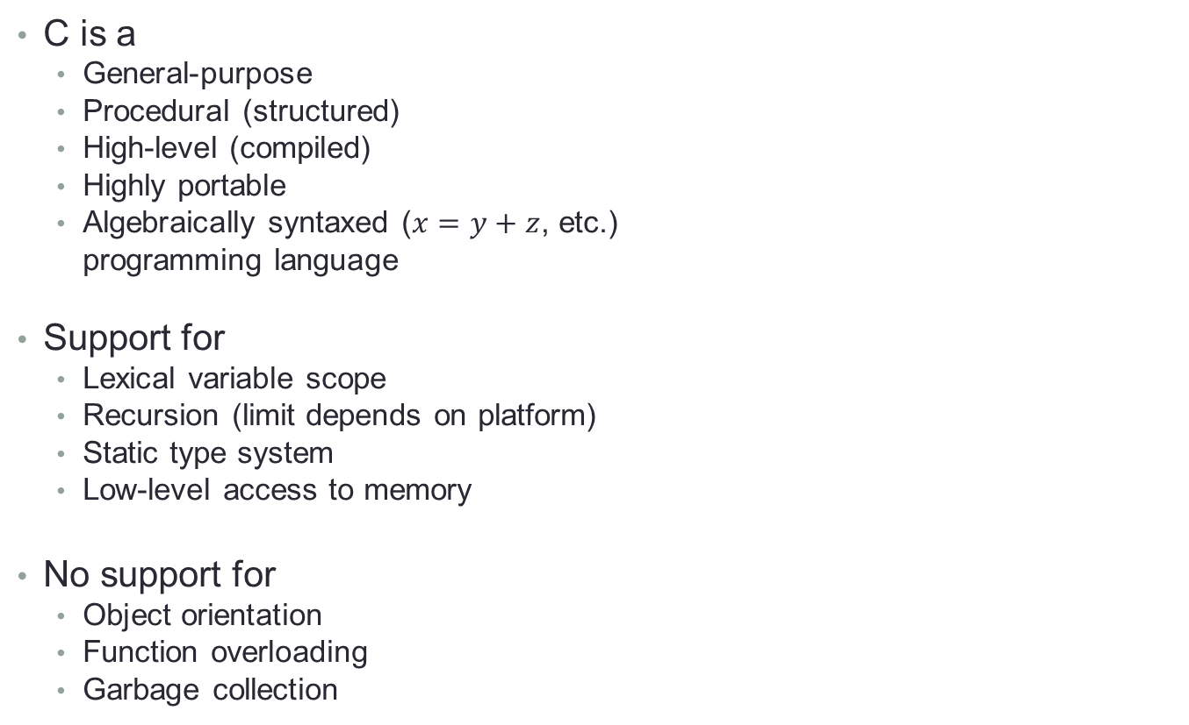
What is C?
C is a
General-purpose
Procedural (structured)
High-level (compiled)
Highly portable
Algebraically syntaxed ($x=y+z$, etc.)
programming language
Support for
Lexical variable scope
Recursion (limit depends on platform)
Static type system
Low-level access to memory
No support for
Object orientation
Function overloading
Garbage collection

Slide 4
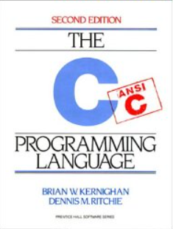
C: A brief history
A successor to B
Developed at
Bell Labs, 1978+
Original author
Dennis Ritchie
Original purpose
Implementing the UNIX OS kernel
Best learnt from:
Kernighan and Ritchie’s K&R C
Now standardized
By ANSI (ANSI C), and also by the ISO

Slide 5
C: Advantages
Advantages
High-level
Simplifies code-writing, system development, debugging
Intermediate-level
Low-level access to system resources like memory (through pointers)
Highly portable
Between controller / microprocessor architectures
x86-64, x86 (Intel), ARM, 8051, PIC, AVR, MIPS, PowerPC, SPARC, …
Between Operating systems
Linux, Unix, Windows, macOS, Solaris, …
‘Fast’
Minimum run-time demands on system resources

Slide 6
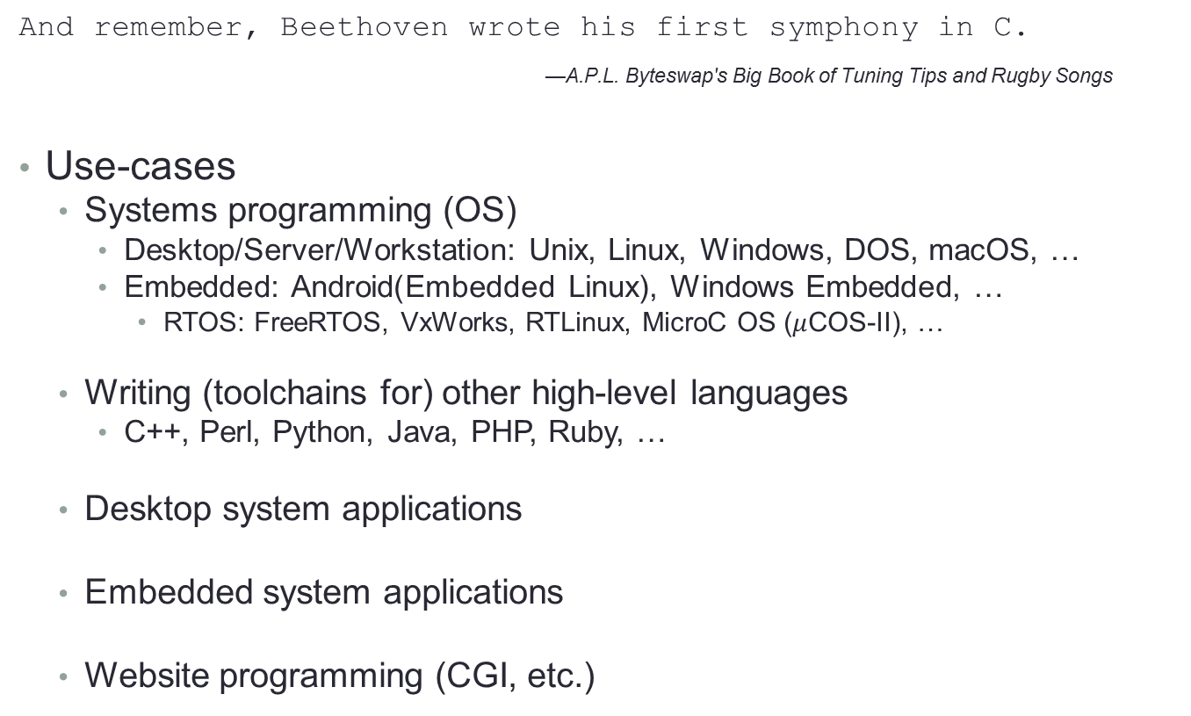
C: Use-cases
And remember, Beethoven wrote his first symphony in C.
—A.P.L. Byteswap's Big Book of Tuning Tips and Rugby Songs
Use-cases
Systems programming (OS)
Desktop/Server/Workstation: Unix, Linux, Windows, DOS, macOS, …
Embedded: Android(Embedded Linux), Windows Embedded, …
RTOS: FreeRTOS, VxWorks, RTLinux, MicroC OS ($μ$COS-II), …
Writing (toolchains for) other high-level languages
C++, Perl, Python, Java, PHP, Ruby, …
Desktop system applications
Embedded system applications
Website programming (CGI, etc.)

Slide 7
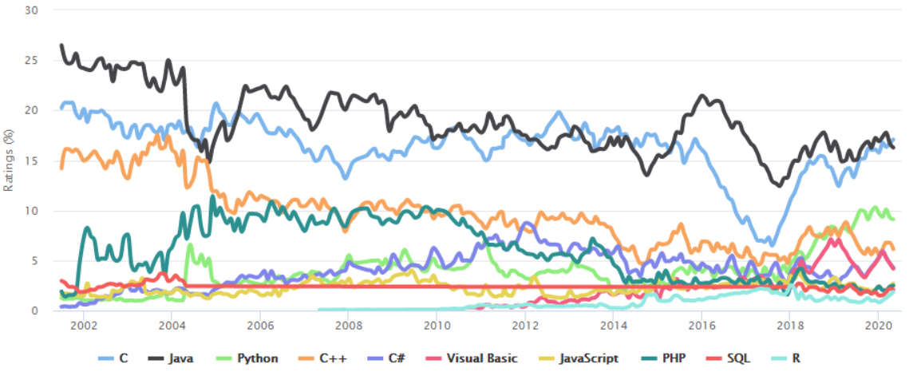
C: Current ‘market status’
TIOBE Index for programming language popularity

Slide 8
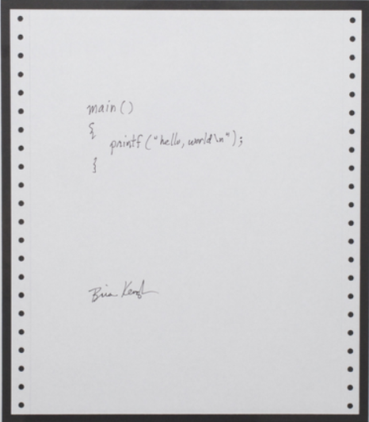
C: Hello world program (PC)
Standard method to evaluate a language
Write a hello world program
Portable
Machine / Chip Architecture wise
Operating system wise
Header file include
#include <stdio.h>
int main(int argc, char *argv[])
{
printf(“Hello world!\n”);
return 0;
}
Entry point
Function code
demarcation
Line demarcation

Slide 9
C: Executable creation – Toolchain
Pre-processor
Handles all lines starting with “#”
#include Bodily include headers, etc.
#define Macro definition, text replacement, etc.
#if, #else, #ifdef, #endif Conditional compilation
#pragma, … Chip/platform specific extensions
Compiler
‘Compiles’ C code to chip’s assembly counterpart
Assembler
‘Assembles’ assembly code to machine/object code
Linker
‘Links’ all object code files
Resolves all symbols (variables, functions, etc.)
Pulls in library files, external code (if any)
Creates proper executable for platform

Slide 10
C: Code syntactic elements
Case-sensitive language!
Keywords
if / else, do / while, for, while, switch, break, continue, etc.
Variables
Denoted by alpha-numberics (cannot start with a number!)
x, X, var1, loop_counter_2, isPossible, flag-var, etc.
Need to have a data-type
Data-types
Internal (native)
int, char, float, double
arrays of native data-types (use [ ] syntax)
strings – bunches of characters (always automatically null terminated)
User-defined
Newly created: typedef
Aggregates: struct, union
Enumerated: enum
Low-level memory access
Through ‘pointer’ variables

Slide 11
C: Operators
Family | Operator(s)
Arithmetic | + - * / %
Assignment | =
Augmented assignment | += -= *= /= %= &= |= ^= <<= >>=
Bitwise logic | ~ & | ^
Bitwise shifts | << >>
Boolean logic | ! && ||
Conditional evaluation | ?:
Equality testing | == !=
Order relations | < <= > >=
Reference, dereference | & * [ ]
Type conversion | (typename)
Member selection | . ->

Slide 12
C: Program structure and flow
Entry point at main()
Functions keep calling functions
Function nesting
Program ends when main()returns
Function call-stack / call-order
Forward
OS → main() → printf()
Reverse
printf() → main() → OS
Comments
Single-line comment starts with //
// This is a comment!
Multi-line comments start with /* and end in */
/*
And this is a
multi-line
comment!
*/
#include <stdio.h>
int main(int argc, char *argv[])
{
// help me!
printf(“Hello world!\n”);
/* Do you
really need help?
*/
return 0;
}

Slide 13
C: Behind the scenes – runtime, life-cycle
High-level languages need ‘setup’ before they can run
Software stack mechanisms
Memory management, space for locals
Exception handlers
Compiler / platform specific extensions (such as pragmas)
Call to entry points (for C, this is main())
This is typically done by:
The OS (if there is one), in conjunction with,
The language’s runtime routines
For C, this is C runtime (called crt0)
Program life-cycle
Compilation of source code to executable
Loading executable into system memory (RAM) [from disk/FLASH]
Dynamic library/module loading if any
Execution from entry point
Exit back to the system

Slide 14
C: Function API / signature
A C function has an API – Application Programming Interface
Also called its signature
What it takes in - Input argument(s)
What it gives out - Output argument
General function syntax
output_arg function_name(input_args)
{
// function code
return output_arg;
}
Every call to a function
Must adhere to its API
Examples:
int main(int argc, char *argv[])
float add_func(float a)
char strlen(char *str_in)

Slide 15
C: More on function APIs
If a function does not take any input
output_arg function_name(void)
If a function does not give any output
void function_name(input_args)
If a function neither takes input(s) nor gives any output
void function_name(void)

Slide 16
C: Command-line arguments
A C executable can interact with the ‘command line’
Take input as well as give output
In this case, main()’s API is:
int main(int argc, char *argv[])
Takes argc (int), argv (strings) and returns an int (status) [to OS]
Command line framework
For ingesting, parsing, and getting each argument
Examples:
C:\dir d:\test_dir /p (Windows command line)
$ ls –al /etc/ (Unix/Linux command line)

Slide 17
C: What does code look like?
C code inside functions:
Defines variable(s)
int x, char y = ‘f’;
Assigns values to (previously defined) variable(s)
x = y + (z / w); r = 100;
Implements flow control
if (x==1) { y = 10 + z; x = x * x + y; }
for (i=0;i<10;i++) { z = y + x; }
Calls other functions
printf(“Hello world\n”);
scanf(“%c”, &a);
Returns output argument when function returns
return; // from a function returning “void”
return (x + y - z);

Slide 18
C: Variable scope
Scope
Area / region of the program where the variable is ‘defined’
Global scope: Throughout the program
int a; // defined outside of all functions!
Local scope:
Inside function where it is defined
Cannot be accessed anywhere else, outside the function
int func2(int x, char y)
{
float b; // b is local (private to func2)
…
}
char func3(void)
{
a = 10; // works - since a is global!
b = 10.24; // error - b is not within this scope!
}
b’s scope
a’s scope

Slide 19
C: Looping constructs
For loop
int i;
for (i=0; i<100; i++)
{
// do something!
}
While
while(x<10)
{
// keep doing it!
}
Do-while
do {
// something!
} while (x<100);
Infinite for loop!
for(;;)
{
// some code?
}
Infinite while loop!
while(1)
{
// some code?
}

Slide 20
C: Conditional flow
If, else
if (x==10)
{
//do things for x equal to 10!
}
else // x!=10
{
// do things for x not equal to 10!
}

Slide 21
C: Switch
Switch and execute code for a particular ‘case’
int x;
switch (x)
{
case 1: // do things for x==1
y += 12;
break;
case 2: // do things for x==2
y -= 10;
break;
case 3: // do things for x==3
y /= 67;
break;
…
default: // if x is none of the above!
y = 0;
}

Slide 22
C for pic18f on MPLABX using the XC8 toolchain

Slide 23
MPLABX: Simplest C program
C on PIC is Embedded C – a subset of standard C
Using XC8 C compiler / toolchain (v2.20)
Simplest C program in MPLABX
#include <xc.h>
void main(void)
{
NOP();
}
Take a look at:
Program memory
Disassembly listing
Ensure proper configuration bit patterns are included!
Single-stepping / debugging differences!

Slide 24
MPLABX: Software delays in XC8
In-built software delay functions
#include <xc.h>
#define _XTAL_FREQUENCY 5000000 // in Hertz
void main(void)
{
_delay(10); // in cycles
return;
}
#include <xc.h>
#define _XTAL_FREQ 7000000 // in Hertz
void main(void)
{
__delay_ms(100); // in msecs
__delay_us(1900); // in microsecs
}

Slide 25
MPLABX: Standard library in XC8
Example: abs (absolute value function)
#include <xc.h>
#include <stdlib.h>
int getabs(int x)
{
int out;
out = abs(x);
return out;
}
void main(void)
{
int x, y;
x = -10;
y = getabs(x);
return;
}

Slide 26
MPLABX: C arrays
Arrays are fixed-size ‘collections’ of the same data-type
The ‘bunch’ of variables are consecutively located in memory
Array ‘elements’ are accessed through [ ] operators
C follows the zero-based counting system (first element is x[0])
#include <xc.h>
#include <stdlib.h>
#define LEN 10
void main(void)
{
int x[LEN], y[LEN]; // indices go from 0 to (LEN-1)
int i;
for (i=0;i<LEN;i++)
x[i] = -i; // x[0], x[1], … x[LEN-1]
for (i=0;i<LEN;i++)
y[i] = abs(x[i]);
return;
}

Slide 27
MPLABX: C pointers
Pointers in C ‘point’ to underlying variables of specific datatypes
Defined thus: data_type *pointer_name;
Pointing is done by & operator
Dereferencing is done by * operator
#include <xc.h>
void main(void)
{
int x, y;
int *x_ptr; // pointer definition
x_ptr = &x; // pointer initialization
x = 100;
y = x;
*x_ptr = 20; // pointer dereferencing
return;
}

Slide 28
MPLABX: C structs
Structs: Variables that can aggregate multiple data-types
#include <xc.h>
struct collection
{
int x;
char y;
float f;
} collection;
void main(void)
{
struct collection c;
c.x = 10;
c.y = 'a';
c.f = 10.345;
return;
}

Slide 29
MPLABX: C pointers to structs!
We can define pointers to structs as well
First glimpse into the power of pointers!
#include <xc.h>
struct collection
{
int x;
char y;
float f;
} collection;
void main(void)
{
struct collection c;
struct collection *c_ptr = &c;
c_ptr->x = 10;
c_ptr->y = 'a';
c_ptr->f = 10.345;
return;
}
ALT-SHIFt-1 for getting variables

Slide 30
MPLABX: C function pointers
C treats everything as variables
Including functions!
Thus, functions can also have pointers pointing to them
These pointers are called ‘function pointers’
Function pointers are special data-types
They depend on the underlying function’s API
Function: int add (int x, int y)
Function pointer: int (*add_pointer)(int x, int y)
Function pointer initialization:
add_pointer = add;
OR
add_pointer = &add;
Function pointer dereferencing:
add_pointer(a, b); // calls add()!

Slide 31
MPLABX: C function pointers in action
Let’s take 2 functions add()and sub()with matching APIs
#include <xc.h>
int add(int x, int y)
{
return x+y;
}
int sub(int x, int y)
{
return x-y;
}
void main(void)
{
int out, result;
int (*f_ptr)(int x, int y);
f_ptr = add; // f_ptr points to ‘add’
result = f_ptr(1, 2); // dereferencing f_ptr will call ‘add’
f_ptr = &sub; // f_ptr points to ‘sub’
result = f_ptr(1, 2); // dereferencing f_ptr will call ‘sub’
out = result;
return;
}

Slide 32
MPLABX: C I/O port access
IO ports (and most registers) are available in C
Syntax: Register name in ALL-CAPS
Examples: TRISA, PORTD, INTCON, CCP1CON, etc.
Bits of specific registers are available through ‘structs’
Register name in ALL-CAPS, followed by the word ‘bits’ (small!)
Followed by . and then the bit name in ALL-CAPS
Examples: TRISAbits.TRISA0, PORTBbits.RB0, etc.
Code snippets:
TRISB = 0; // port-wise output
PORTB = 0x23; // send 0x23 out on PORT B
TRISAbits.TRISA4 = 0; // set RA4 to output
PORTAbits.RA4 = 1; // now send 1 out

Slide 33
MPLABX: IO port programming
Read bit 2 of PORT C, and send it to bit 3 of PORT B
C version
Assembly version
#include <xc.h>
#define IN PORTCbits.RC2
#define OUT PORTBbits.RB3
void main(void)
{
unsigned char t;
TRISCbits.TRISC2 = 1;
TRISBbits.TRISB3 = 0;
while (1)
{
t = IN;
OUT = t;
}
return;
}
#include “P18F4520.inc”
ORG 0x0
BSF TRISC, 2
BCF TRISB, 3
AGAIN BTFSC PORTC, 2
BRA SET
BCF PORTB, 3
BRA AGAIN
SET BSF PORTB, 3
BRA AGAIN
END

Slide 34
MPLABX: Serial programming
Send out a byte 0x23 on RD5, serially, MSB first!
C version
Assembly version
#include <xc.h>
#define OUT PORTDbits.RD5
void main(void)
{
int i;
unsigned char val = 0x23;
unsigned char tmp = val;
TRISDbits.TRISD5 = 0;
for (i=0;i<8;i++)
{
OUT = (tmp>>7)&(0x01);
tmp = tmp<<1;
}
return;
}
#include “P18F4520.inc”
VAL EQU 0x23
MASK EQU b’10000000’
MSKREG EQU 0x10
CNT EQU d’8’
CNTREG EQU 0x20
ORG 0x0
BCF TRISD, 5
MOVLW CNT
MOVWF CNTREG
MOVLW MASK
MOVWF MSKREG
LOOP MOVLW VAL
ANDWF MSKREG, W
BZ ZERO
BSF PORTD, 5
BRA DONE
ZERO BCF PORTD, 5
DONE RRNCF MSKREG, F
DECFSZ CNTREG, F
BRA LOOP
GOTO $
END

Slide 35
MPLABX: Parallel programming
Send out a byte 0x23 on PORT B
C version
Assembly version
#include <xc.h>
void main(void)
{
unsigned char val = 0x23;
TRISB = 0;
PORTB = val;
return;
}
#include “P18F4520.inc”
VAL EQU 0x23
ORG 0x0
CLRF TRISB
MOVLW VAL
MOVWF PORTB
END
f

Slide 36
MPLABX: C variables in code memory
Akin to assembly
C can also put variables (data) into code memory
#include <xc.h>
// put str at 0x200 in code/program memory
const char str [] @0x200 = "Hello";
void main(void)
{
NOP();
return;
}

Slide 37
MPLABX: C data to code memory moves
Akin to assembly
C can also move data from code memory to data memory
#include <xc.h>
#include <string.h>
const char str_codemem[] @0x200 = "Hello world!";
void main(void)
{
int i;
char str_datamem[100] = {0};
for(i=0;i<strlen(str_codemem);i++)
str_datamem[i] = str_codemem[i];
return;
}

Slide 38
MPLABX: C interrupts (simulation)
main.c
interrupts.c
#include <xc.h>
void main(void)
{
int i;
INTCONbits.GIE = 1;
INTCONbits.TMR0IE = 1;
INTCONbits.TMR0IF = 0;
for (i=0;i<10;i++)
{
if (i==5)
INTCONbits.TMR0IF = 1;
}
return;
}
#include <xc.h>
void interrupt high_isr(void)
{
INTCONbits.TMR0IF = 0;
return;
}

Slide 39
PIC18F: C programming summary
C programming language
Overview
History
Use-cases
Limitations
Variables, syntax, quirks
C on PIC18F
Using XC8 v2.20 toolchain
Project creation, debugging
C programs, standard library (introduction)
C use-cases vis-à-vis assembly code

Slide 40
Thank you!

